Slide 1
Gender
2018

Slide 2
– List differences between women and men and consider:
On what are these perceived differences based? (e.g. biological, social, cultural or religious beliefs)
– List similarities between women and men and consider:
On what are the perceived similarities based? (e.g. biological, social, cultural or religious beliefs)
2018

Slide 3
All participants to consider together:
To what extent do assumptions about biologically determined sex differences between women and men influence popular culture, sayings or beliefs in your cultural setting?
2018

Slide 4
The Social Construction of Gender
So-called “natural differences” have been used to justify unequal opportunity in education, employment, politics, and more
  Women were once thought incapable of succeeding at college because of their biological makeup
Our cultural suppositions are more rooted in our social constructions of what is natural than in biological limitations
2018

Slide 5
Sex and Gender
Sex: biological differences between males and females
  Refers to who we are as males and females
Gender: the social and cultural significance we attach to those presumed biological differences
  Refers to what we become as men and women, which occurs through socialization
2018

Slide 6
SEX
categorization of people into male
and female groups based on biological
characteristics
XX (female) or XY
(male)
chromosomes
eggs or sperm
facial hair
breasts
“female, male”
GENDER
cultural or social
interpretation of sex
Behavioral expectations associated with being a socially appropriate man or woman
masculine
feminine
“man”
“woman”
2018

Slide 7
Sex
Sex refers to the physical and biological
attributes of men and women
Sex includes the chromosomal, hormonal, and anatomical components of males and females.
2018

Slide 8
Gender and gender identity
Gender refers to the social, psychological and
cultural attributes of masculinity and femininity,
many of which are based on biological distinctions
    – Gender includes people’s self image and
    expectations for behavior among other things
Gender describes societal attitudes and behaviors expected of and associated with the two sexes.
Gender is a social construct that is determined by culture and society and defines man-woman relationship that is changeable.
Gender identity refers to the degree to which an
individual sees herself or himself as feminine or
masculine based on society’s definitions of appropriate gender roles.
2018

Slide 9
Gender Characteristics?
Generally, sex is considered to be an ascribed status while gender is an achieved status
Examples of gender characteristics? What
physical, emotional, or other characteristics
are considered “masculine” or “Feminine”?
2018

Slide 10
Ideology of gender determines–
– What is expected of us
– What is allowed of us
– What is valued in us
– The nature and extent of
• Disadvantage
• Disparity
• Discrimination
2018

Slide 11
Manifestation of gender differences can be found in
• Construction of Roles-What women and Men do
• Relations- How women and men relate to each other
• Identity-how women and men perceive themselves
2018

Slide 12
Ideology of Gender Contains norms and rules regarding appropriate behavior
• Determines attributes
• Reproduces range of beliefs and customs to support these norms and social rules
• Norms and rules determine material reality of
relative access of men and women to and claims over different resources. E.g. food, health, education, property, job, opportunities & entitlements, so on & so forth
2018

Slide 13
Social construct
A social construction is something that doesn't
exist independently in the "natural" world, but is
instead an invention of society.
Cultural practices and norms give rise to the
existence of social constructs and govern the practices, customs, and rules concerning the way
we use/view/understand them.
In other words, we all act as if they exist, and
because of our intersubjective agreement, they do
2018

Slide 14
Gender Construction
For the individual, gender construction starts
with assignment to a sex category on the basis of what the genitalia look like at birth.
Then babies are dressed or adorned in a way that displays the category because parents don't want to be constantly asked whether their baby is a girl or a boy.
A sex category becomes a gender status through naming, dress, and the use of other gender markers
2018

Slide 15
Once a child's gender is evident, others treat
those in one gender differently from those in the
other, and the children respond to the different
treatment by feeling different and behaving differently.
As soon as they can talk, they start to refer to
themselves as members of their gender.
Sex doesn't come into play again until puberty,
but by that time, sexual feelings and desires and
practices have been shaped by gendered norms
and expectations.
2018

Slide 16
Parenting is gendered, with different expectations for mothers and for fathers, and people of different genders work at different kinds of jobs.
The work adults do as mothers and fathers and as low-level workers and high-level bosses, shapes women's and men's life experiences, and these experiences produce different feelings, consciousness, relationships, skills - ways of being that we call feminine or masculine.
All of these processes constitute the social
construction of gender.
2018

Slide 17
Gender as a construct
Gender is a process, stratification system and structure;
  Process = day to day interactions reinforce gender as opposites. For examples, conversations, rituals of daily life, sayings, etc
  Stratification = Men as a group have more status and power than women as a group. Women are treated as “other,” and compared to men.
  Structure = Gender divides work in the home and economic production. It legitimates those in authority and organizes sexuality and emotional life.
2018

Slide 18
Gender as a social construction
What is necessary for society’s perpetuation?
Rules for allocating goods
Assigned responsibility for children and others who can’t care for themselves
Common values and the transmission of them.
Legitimate leadership.
Expression of the above through arts, music, stories, etc.
What social categories influence the way the above exist?
2018

Slide 19
why gendering from birth?
Gender is one of the major ways that human beings organize their lives.
• Human society depends on
    – a predictable division of labor,
    – a designated allocation of limited goods,
    – assigned responsibility for children and others who cannot care for themselves,
    – common values and their systematic transmission to new members,
    – legitimate leadership,
    – music, art, stories, games,
    – and other symbolic productions
2018

Slide 20
One way of choosing people for the different
tasks of society is on the basis of their talents,
and competence - their demonstrated
achievements, while other is on the basis of
gender, race, ethnicity - ascribed membership
in a category of people.
2018

Slide 21
Every society classifies people on the basis their age and gender then constructs similarities among them and differences between them, and assigns them to different roles and responsibilities.
Personality characteristics flow from these
different life experiences so that the members
of these different groups become different kinds of people.
2018

Slide 22
So Gender as a social construction does not flow automatically from genitalia and reproductive organs
In the construction of ascribed social statuses, physiological differences such as sex, stage of development, color of skin, and size are crude markers.
They are not the source of the social statuses of gender, age grade, and race.
Social statuses are carefully constructed through prescribed processes of teaching, learning, emulation, and enforcement.
Whatever genes, hormones, and biological evolution contribute to human social institutions is materially as well as qualitatively transformed by social practices.
2018

Slide 23
So…..
The building blocks of gender are socially
constructed statuses.
2018

Slide 24
Gender and body
Many cultures go beyond clothing, gestures, and behaviors in gendering children.
They inscribe gender directly into bodies.
Examples
    Traditional Chinese society through binding feet into three-inch stumps to enhance their sexual attractiveness.
    Women in African societies remove the clitoris of prepubescent girls and scrape their labia to preserve their chastity and ensure their marriage ability.
    Jewish and Muslim fathers circumcise their infant sons to show their covenant with God.
    In Western societies, women augment their breast size with silicone and reconstruct their faces with cosmetic surgery to conform to cultural ideals of feminine beauty
2018

Slide 25
Gender and Inequality
Gender stratification refers to the unequal distribution of wealth, power, and privilege between men and women.
Men and women differ in their access to privilege, prestige, and power.
Traditionally, men have been first in line when it comes to who gets what, when, and how.
Sex is a biologically determined characteristic, while gender is a socially constructed characteristic.
All societies use anatomical differences to assign gender roles.
Gender identities are the conceptions we have of ourselves as being male or female. Sexism operates at both an individual and an institutional level.
2018

Slide 26
“Gender inequality […] has social functions and social history. It is produced and maintained by identifiable social processes and built into the general social structure and individual identities deliberately and purposefully.[…]The continuing purpose of gender as a modern social institution is to construct women as a group to be the subordinates of men as a group.”
2018

Slide 27
Sources of Gender Differences
Gender roles can be seen as arising from biological development or cultural contributions.
The biological aspects of gender consist of the physical differences between men and women.
Gender roles probably represent the earliest division of labor among humans.
Gender identities are the concepts we have of ourselves as being male or female.
Theories of the acquisition of gender identities include the Freudian approach, cultural transmission, and cognitive development.
2018

Slide 28
Sociological Perspectives on Gender Stratification
The major sociological perspectives offer interpretation of gender stratification that resemble and parallel their positions on class and racial or ethnic stratification.
Functionalists suggest that families are organized along instrumental-expressive lines, with men specializing in instrumental tasks and women in expressive tasks.
2018

Slide 29
Conflict theorists contend that a sexual division of labor is a social vehicle devised by men to ensure themselves of privilege, prestige, and power in their relationships with women.
Symbolic Interactionists argue that gender inequality persists because of the way we define men and women and their appropriate roles in society. Language helps perpetuate inequality. Feminists argue that women are disadvantaged because society is patriarchal
2018

Slide 30
Gender Differences Across cultures
Sex is considered as irrelevant to most areas of life in the Israeli kibbutzim, yet traditional gender roles seem to be reasserting themselves there.
Margaret Mead studied gender in three New Guinea societies:
    Among the Arapesh, both sexes would be described by U.S. citizens as feminine.
    Among the Mundugumor, both sexes would be described by U.S. citizens as masculine.
    Among the Tchambuli, gender roles reverse U.S. standards.
    Mead concluded that these case studies prove that gender does vary across cultures.
    Critics charge that Mead oversimplified.
2018

Slide 31
In sum, what is considered to be female or male is mostly a creation of society.
    George Murdock surveyed over 200 societies and found substantial but not complete agreement concerning which tasks are feminine or masculine.
2018

Slide 32
Gender Roles
Gender roles: expectations regarding proper behavior, attitudes, and activities of males and females
Gender-Role Socialization
  Boys must be masculine: active, aggressive, tough, daring, and dominant
  Girls must be feminine: soft, emotional, sweet, and submissive
© 2009 The NcGraw Hill Companies

Slide 33
Gender Roles
Gender-Role Socialization
  Occurs through influences of parents, older siblings, mass media, religious and educational institutions, and other adults
© 2009 The NcGraw Hill Companies

Slide 34
Gender Roles in the United States
Women’s Gender Roles
  2004 Dove Campaign for Beauty found that only 2 percent of women around the world feel comfortable describing themselves as beautiful
  TV consistently portrays women as young, thin, and beautiful
  Children’s books have portrayed most female characters as helpless, passive, and incompetent
© 2009 The NcGraw Hill Companies

Slide 35
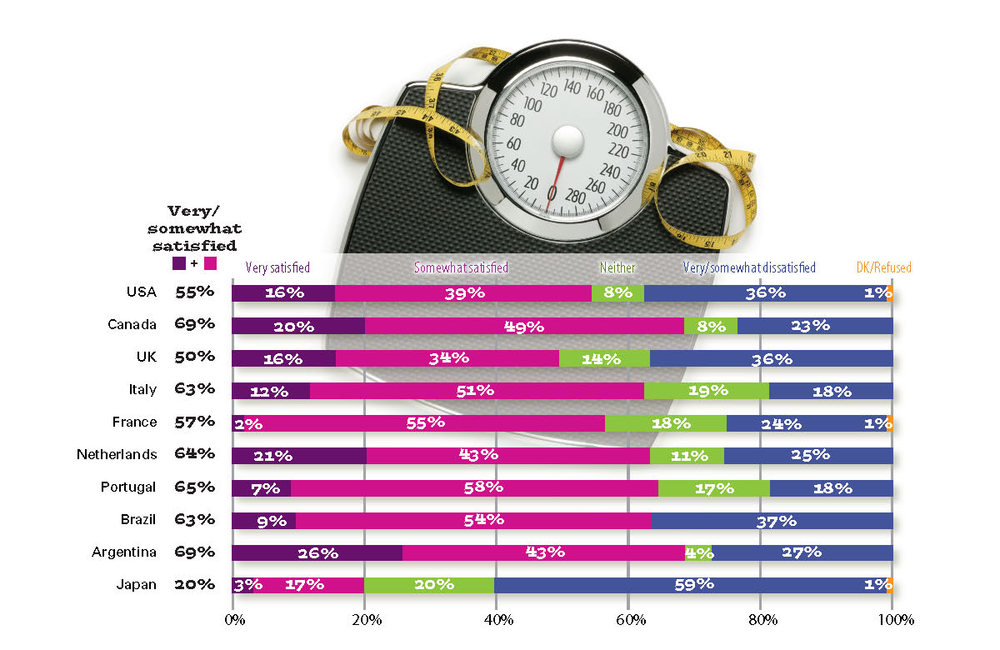
Satisfaction with Body Weight and Shape
© 2009 The NcGraw Hill Companies
Source: Etcoff et al. 2004.

Slide 36
Gender Roles in the United States
Men’s Gender Roles
  Stay-at-home fathers still rare
  Must prove masculinity at work and in sports
  Nonconformists often face criticism and humiliation
  Multiple masculinities: idea that men learn and play a full range of gender roles
© 2009 The NcGraw Hill Companies

Slide 37
Gender and Power
Patriarchy is a form of social organization in which males dominate females. In general, women fare better in rich nations than in poor countries.
Matriarchy is a form of social organization in which females dominate males. No matriarchal societies are known to exist or to have existed.
Sexism is the belief that one sex is innately superior to the other. It underlies patriarchy and harms men, women, and the society as a whole. Patriarchy is not inevitable because modern technology has eliminated most of the historic justifications for it.
2018

Slide 38
  Gender and Socialization.
Gender roles are attitudes and activities that a culture links to each sex.
  Parents treat male and female children differently from birth.
  Peer groups reinforce these differences.
    Boys and girls play different kinds of games and learn different styles of moral reasoning from games.
  Curricula in schools further reinforce a culture’s gender roles.
  The mass media, especially television, also serve this function.
2018

Slide 39
Gender and Social Stratification
  In industrial societies, women working for income is now the rule rather than the exception.
    Sixty-two percent of U.S. married couples depend on two incomes.
  Women continue to enter a narrow range of occupations
    Almost half in clerical or service work.
    The greater a job’s income and prestige, the more likely it is that the position will be held by a male.
    Working has not substantially reduced women’s dominance in housework as men have failed to increase helping more at home.
2018

Slide 40
Gender and Inequality
  The average female full-time worker earns about 76 cents for every dollar earned by a male full-time employee.
    Most of this results from the different kinds of jobs held by men vs. women.
    The greater responsibility for family and childcare tasks that our society has traditionally assigned to women is another factor explaining the earning differential.
    Discrimination is a third critical factor.
2018

Slide 41
Gender and Inequality
Our society still defines high-paying professions as masculine; this helps to explain why an equal number of women and men begin most professional graduate programs, but women are less likely to complete their degrees.
Female involvement in politics is also increasing, although very slowly at the highest levels.
As technology blurs the distinction between combat and noncombat personnel, women are taking on more military assignments, though equality has not yet been achieved.
2018

Slide 42
Gender and Inequality
  While women fit the definition of a minority group, most white women do not think of themselves this way.
  A minority is any category of people, distinguished by physical or cultural difference, that a society sets apart and subordinates.
    Minority women are doubly disadvantaged. This fact is at the heart of intersection theory, the investigation of the interplay of race, class, and gender; often resulting in multiple dimensions of disadvantage.
2018

Slide 43
  Violence against women
Family violence is frequently directed against women.
  Female genital mutilation is practiced extensively in parts of Africa and the Middle East.
  Sexual harassment refers to comments, gestures, or physical contact of a sexual nature that is deliberate, repeated, and unwelcome.
  Women are more likely to be sexually harassed than are men.
  Some harassment is blatant but much of it is subtle.
Feminists define pornography as a form of sexual violence against women, arguing that it demeans women and promotes rape.
2018

Slide 44
Theoretical Analysis of Gender.
Structural-functional analysis suggests that traditional sex roles emerged in hunting and gathering societies where they promoted the efficient functioning of the family.
  Each sex played a role that complemented the role played by the other, with men taking the instrumental part and women the expressive.
  Talcott Parsons argues that gender role complementarity helps to integrate society; that girls and boys are socialized into expressive and instrumental roles respectively; and that social control reinforces gender-linked behavior.
  This view has been criticized as follows:
    It ignores the fact that many women have had to work outside the home due to necessity.
    It ignores the personal strains and social costs produced by rigid gender roles.
    It legitimizes the status quo.
2018

Slide 45
Social-conflict analysis explains contemporary sex roles in terms of dominance, subordination, and sexism.
  This perspective draws heavily on the work of Friedrich Engels, who felt that capitalism intensified male domination.
  This view has been criticized as follows:
    It casts conventional families as morally evil.
    It minimizes the extent to which people live happily in families.
    It argues, perhaps falsely, that capitalism stands at the root of gender stratification.
2018

Slide 46
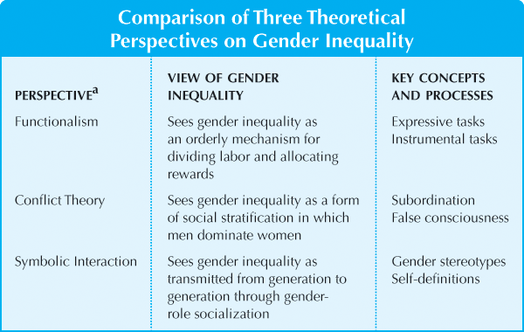
Source: Curry et al Sociology For The Twenty-First Century, Fifth Edition, Pearson Education, Upper Saddle River,2008
2018

Slide 47
Feminism.
Feminism is the advocacy of social equality for the sexes in opposition to patriarchy and sexism.
  Basic feminist ideas:
    Working to increase equality.
    Expanding human choice.
    Eliminating gender stratification.
    Ending sexual violence.
    Promoting sexual freedom.
  Types of feminism:
    Liberal feminism.
    Socialist feminism.
    Radical feminism.
  Opposition to feminism.
    Opposition is primarily directed at its socialist and radical forms, while support for liberal feminism is widespread.
  There is a trend toward greater gender equality.
2018

Slide 48
Looking Ahead: Gender in the Twenty-first Century.
  While changes may be incremental, we are seeing movement toward a society in which women and men enjoy equal rights and opportunities.
2018

